Slide 1
CSCI 316 Big Data Mining Techniques & Implementation
Group Assignment 1
T01 | G12
Name | UOW ID | Contribution
Emily Gong Xue Ying | 7673620 | 100%
Lai Wei Jie | 7770042 | 100%
Lee Kuok Wei | 7673607 | 100%
Li Biyang | 7352670 | 60%

Slide 2
CONTENT
Introduction
Discover and Visualise the Data
Data Preprocessing
User-defined Feature
Select and Train Models
Fine Tuning
Evaluate Outcomes
Conclusion

Slide 3
Classification Problem:
Credit Risk Analysis via Loan Data Set
Target variable: default (index)
a) Discover and visualise the data
b) Preprocessing data for machine learning.
c) Select and train models
d) Fine-tune the models
e) Evaluate outcomes
Dataset: Loan data set for credit risk analysis (https://www.kaggle.com/datasets/rameshmehta/credit-risk-analysis)

Slide 4
DISCOVER & VISUALISE DATA

Slide 5
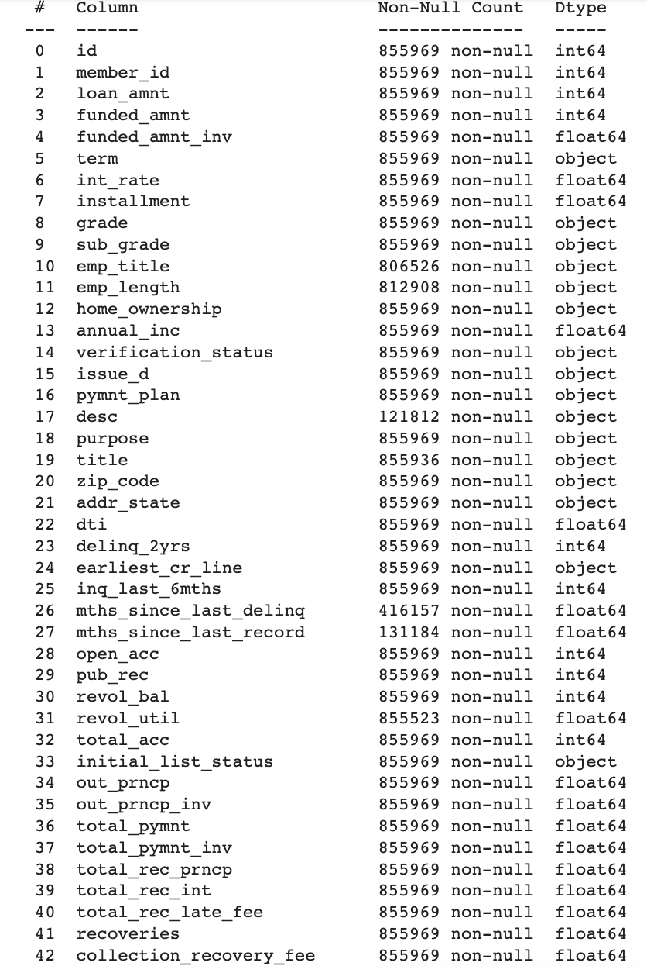
Introduction
df.shape
(855969, 73) - 800k entries, 73 features
Categorical variables:
term (36/ 60 months)
issue_d (date/time)
desc (string descriptions)
First Review on Data:
The dataset is very unbalanced, with approximately 6 % of loans considered as defaulted. This dataset has different types of features such as categorical, numeric & date.

Slide 6
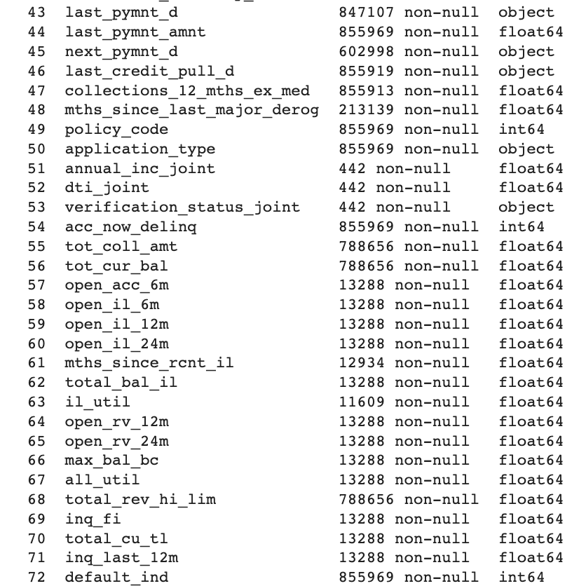
Introduction
Missing variables:
dti_joint (442 non-null)
Mths_since_last_major_deroj (213139 non-null)
Target label:
default_ind

Slide 7
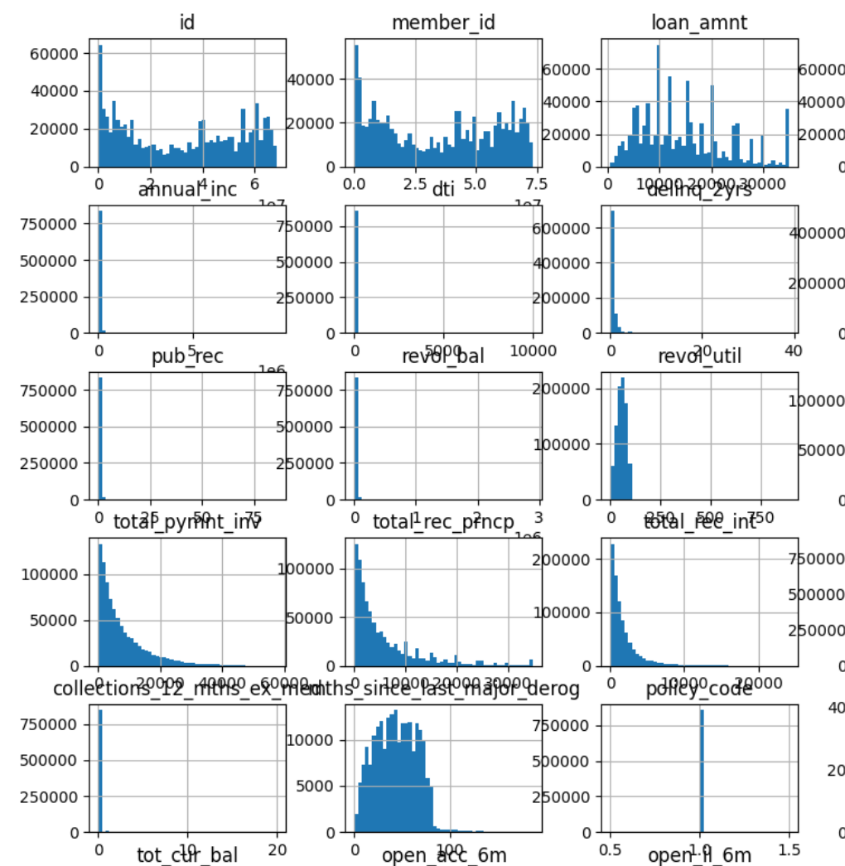
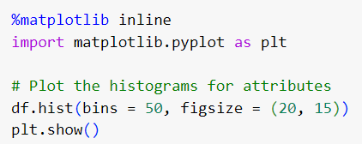
Discover & Visualise Data
Results
Histograms
1) Shape of histograms
Symmetric Distribution
Skewed Distribution
2) Central Tendency
3) Spread
4) Outliers
5) Multimodal Distribution

Slide 8



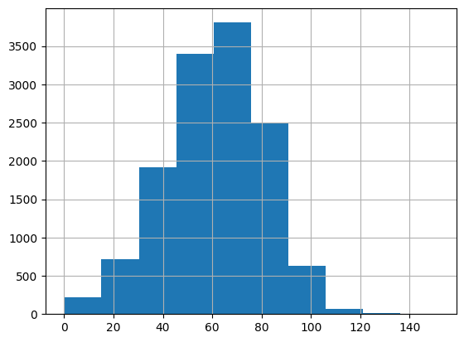
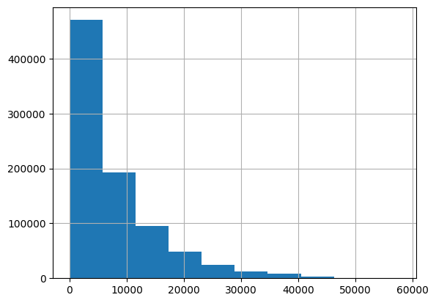
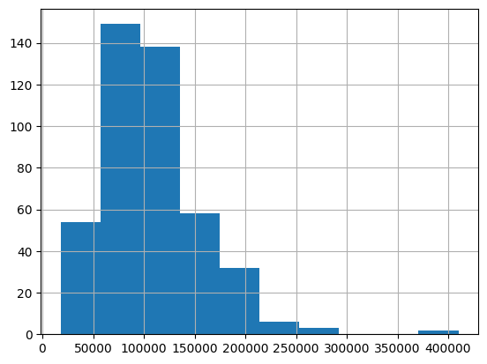
Discover & Visualise Data
Histograms
Outliers example
Symmetric distribution example
Skewed distribution example

Slide 9
DATA PREPROCESSING

Slide 10
Data Preprocessing: Overview
Remove columns with duplicated meanings (Grades and Sub-Grades etc)
Replace descriptive columns with useful columns (date columns form time period)
Extract numbers from obj type column & convert to float (term, emp_length)
Label encoder (ordinal) : sub_grade
One-hot encoder (nominal) : list_status
Missing values via Imputer strategy: median
Outliers:
There is 168074 outliers in pymnt_gap
There is 144596 outliers in last_pymnt_amnt
Standard Scaler (Due to outliers presence)
Remove unuseful columns below correlation threshold of 0.01

Slide 11
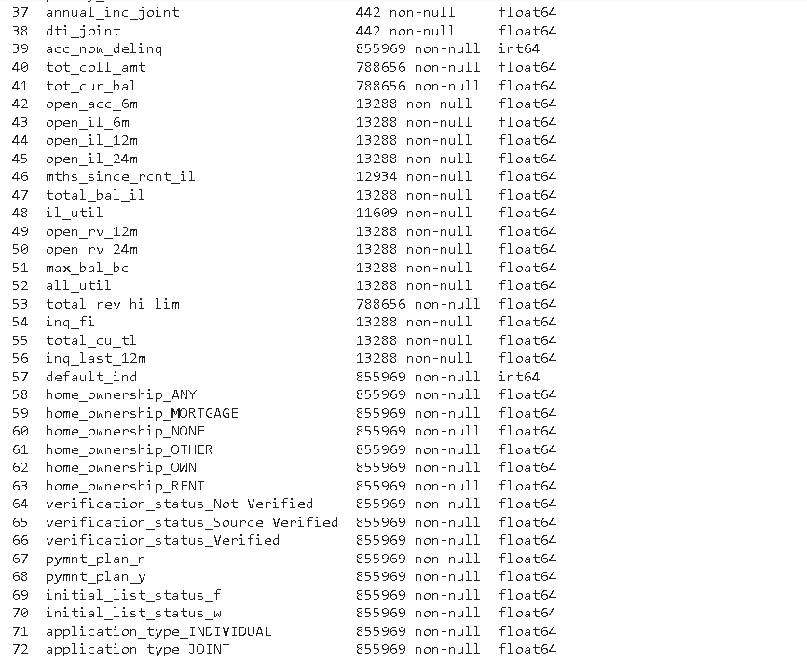
Data Preprocessing:
Final Cleaning on object type columns
Label Encoder | Columns with wider range of values
One Hot Encoder | Columns with few possible values
Label Encoder
sub_grade
purpose
addr_state
One hot Encoder
Home_ownership
Verification_statis
Pymnt_plan
Initial_list_status
application_type
Additional Columns from one hot encoding
Notes:
Standard Scaler vs Normalisation: https://www.youtube.com/watch?v=sxEqtjLC0aM&ab_channel=NormalizedNerd

Slide 12
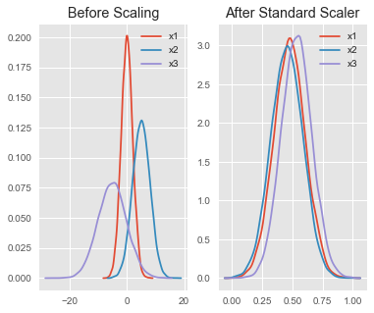
Data Preprocessing:
Standard Scalar
Improved Model Performance
Effective for distance based algorithm
Provide better visualisation
Provide correct interpretability
Less sensitive to outliers than feature scaling
Notes:
Standard Scaler vs Normalisation: https://www.youtube.com/watch?v=sxEqtjLC0aM&ab_channel=NormalizedNerd

Slide 13
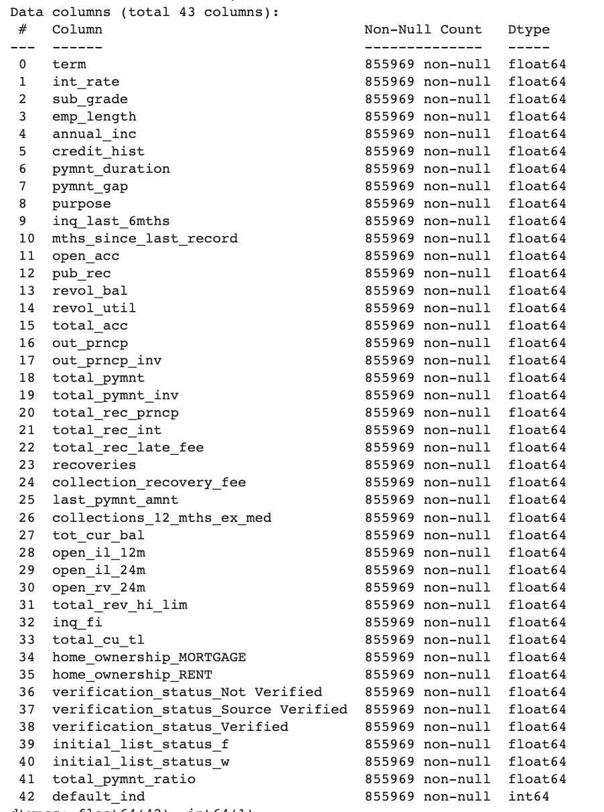
Data Preprocessing:
After Cleaning
Cleaned Data before Splitting and Training:
42 independent variables with significant correlation.
float64 or int64 types only
No missing values
Notes:
Standard Scaler vs Normalisation: https://www.youtube.com/watch?v=sxEqtjLC0aM&ab_channel=NormalizedNerd

Slide 14
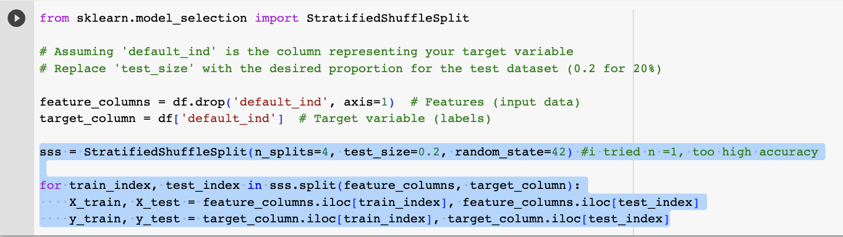
Data Preprocessing:
Stratified Shuffle Split
Drop target feature column (default_ind).
Proportion of class labels is even in SSS.
Split 80 / 20 into train / test datasets.
SMOTE
(Synthetic Minority Oversampling Technique)
Synthesize new samples from minority class so that training and classification is more balanced.

Slide 15
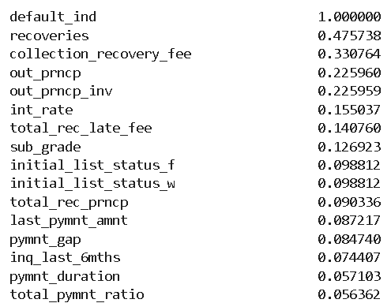
Data Preprocessing:
User-Defined Feature
def add_total_pymnt_ratio(df, flag):
if flag:
df['total_pymnt_ratio'] = df['total_pymnt'] / df['loan_amnt']
return df
df_encoded = add_total_pymnt_ratio(df_encoded, True)
total_pymnt_ratio:
Ratio of payment to total loan
Higher Value = Higher % of loan paid off
Lower Value = Higher % of unpaid balance

Slide 16
SELECT AND TRAIN MODELS

Slide 17
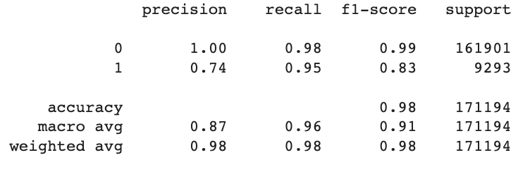

Classification Report
Model 1 Performance:
Linear Support Vector Classifier
Reference to graph on the right, an AUC-ROC score of 0.98 indicates high discriminatory power for the model.
It is able to correctly classify positive and negative classes 98% of the time, assuming an optimal threshold for classification.
Confusion Matrix

Slide 18
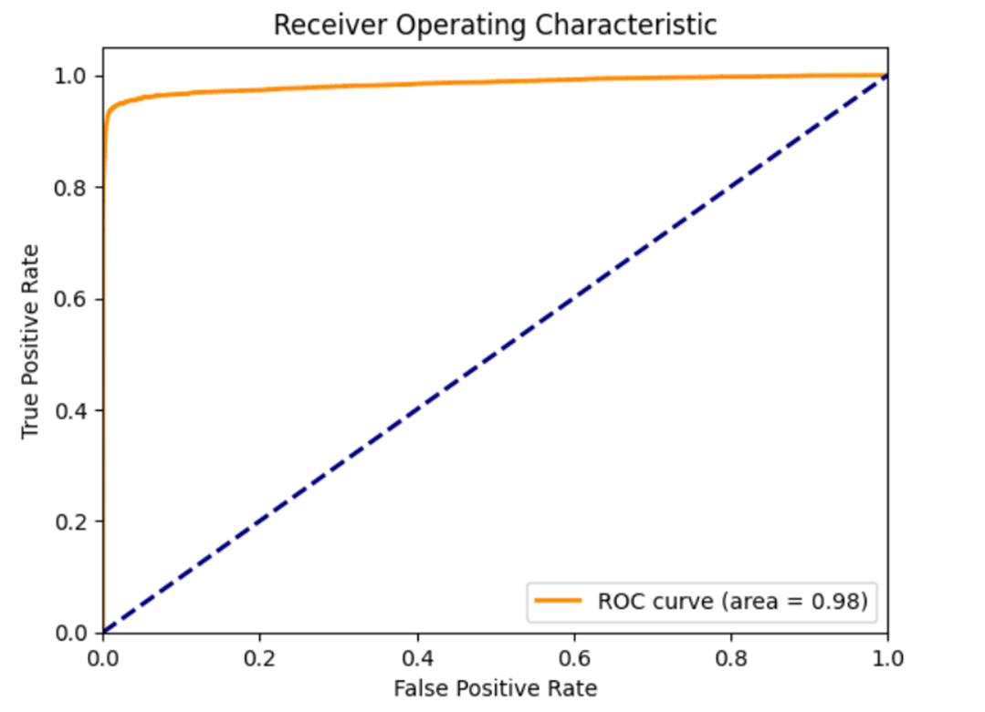
Model 1 Performance: Linear Support Vector Classifier
ROC Curve

Slide 19
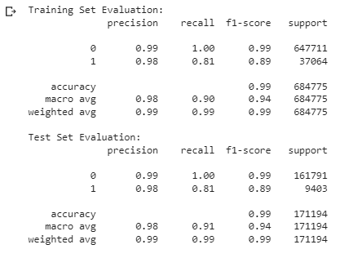
Linear Support Vector: Training & Test Classification Comparison
The evaluation results indicate that the performance metrics on the training set and the test set are relatively consistent.
Conclusion: No overfitting is observed.

Slide 20


Classification Report
Model 2 Performance:
XGBOOST
Similarly, high discriminatory power is inferred for XGBoost model from the classification report as well as an AUC-ROC score of 1.00.
Confusion Matrix

Slide 21
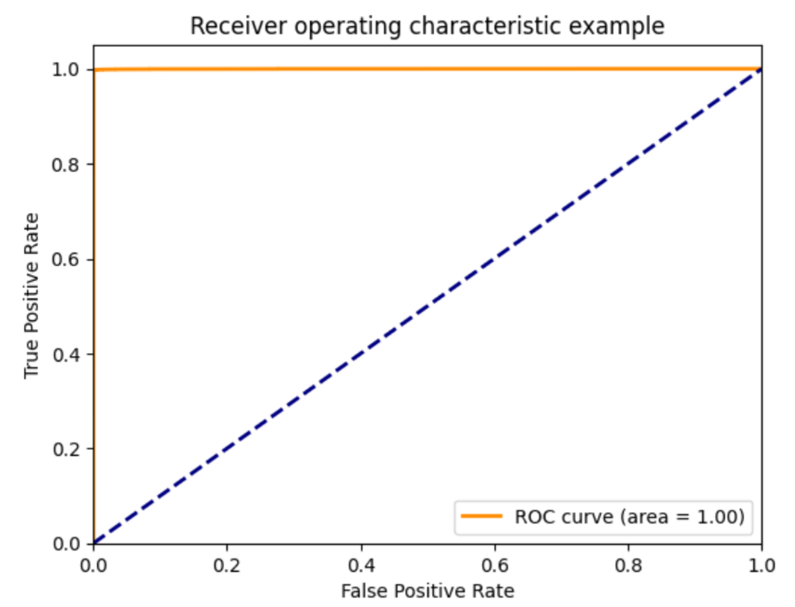
Model 2 Performance: XGBOOST
ROC Curve

Slide 22
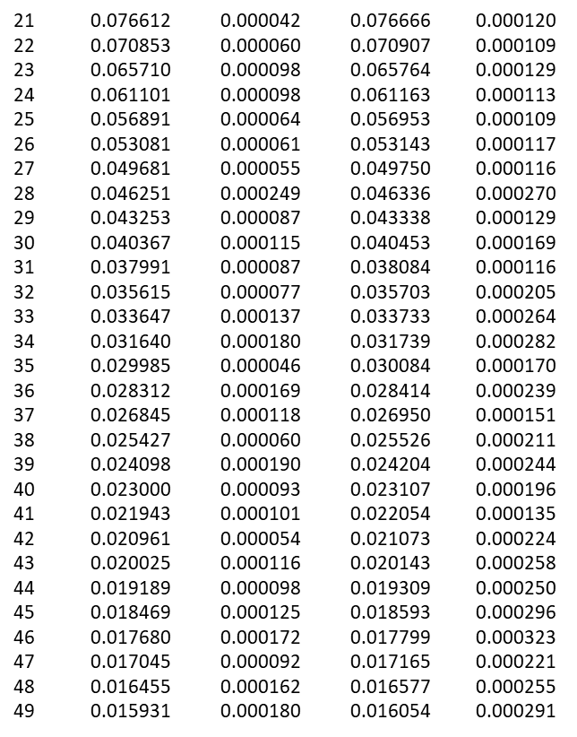
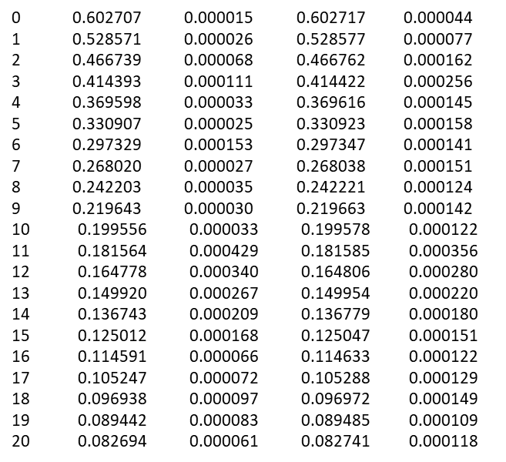
XGBoost: Cross Validation Result

Slide 23
XGBoost: Cross Validation Result Analysis
The train-logloss mean and test-logloss mean values are both steadily decreasing and seem to decrease in tandem. This suggests model is learning general patterns that also apply to the validation set.
No point where the test loss starts increasing while the train loss continues decreasing.
Conclusion: No clear sign of overfitting is observed from the cross validation table.

Slide 24
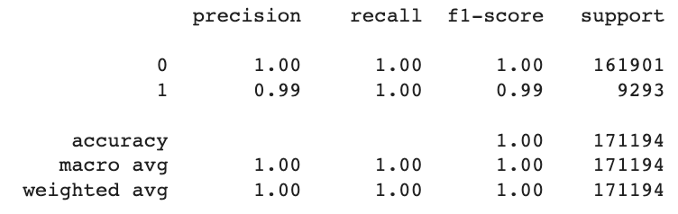


Model 3 Performance:
Decision Tree
Classification report
Accuracy result

Slide 25
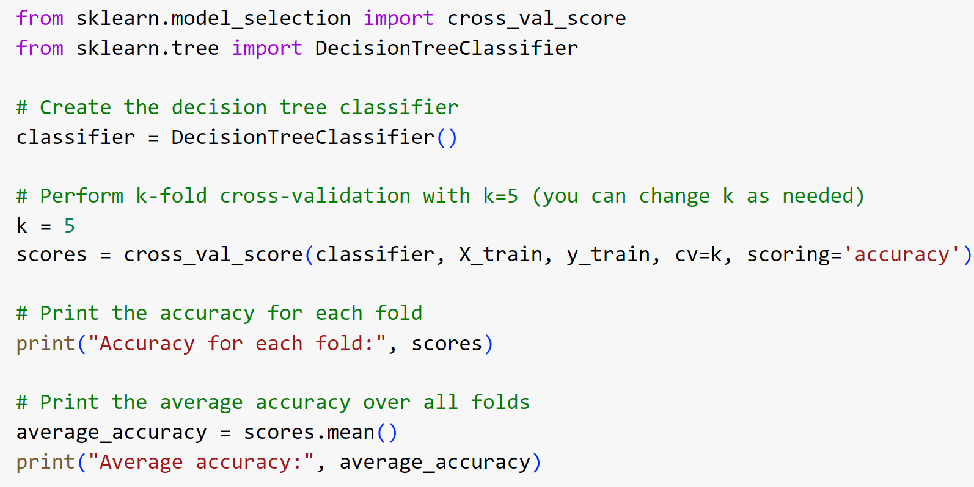
Decision Tree: k-fold cross-validation
the decision tree model has a very high accuracy of around 99%, which is in doubt to be a result of overfitting
K-fold cross-validation splits the data into k subsets (folds), training the model on k-1 subsets, and then evaluating it on the remaining fold. This process is repeated k times, with each subset acting as the test set once
If the average accuracy is close to the accuracy on the training data, it indicates that the model is not overfitting
Implementation code

Slide 26
Decision Tree: k-fold cross-validation analysis
From the results shown, the accuracy for each fold is highly similar to the average accuracy. Thus, this indicates that the model is not overfitting.
Result

Slide 27
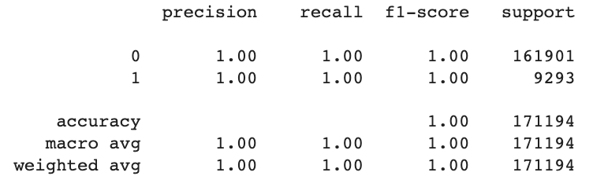
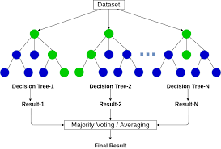
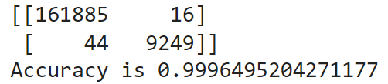
Model 4 Performance:
Random Forest
Classification report
Accuracy result

Slide 28
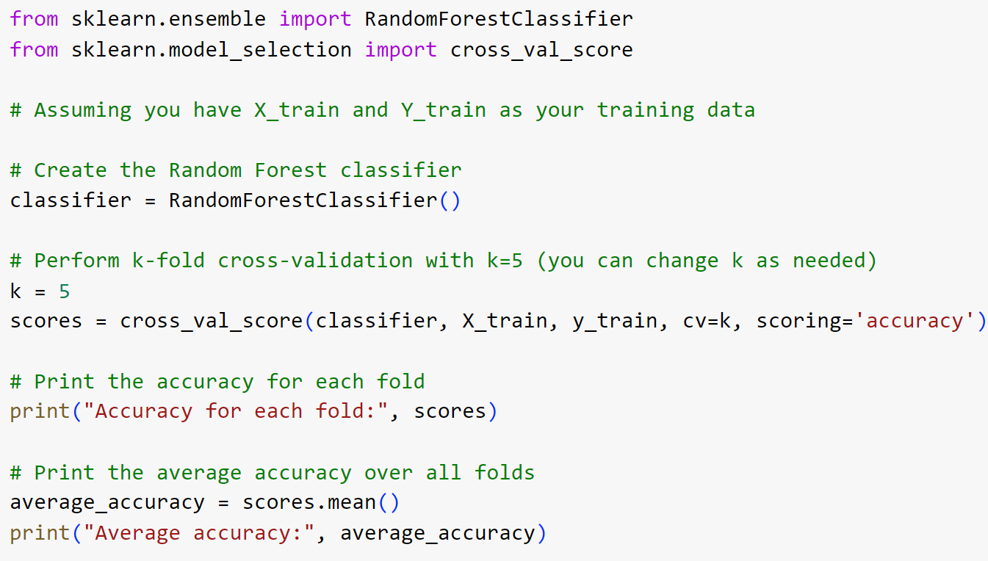
Implementation code
Random Forest: k-fold cross-validation & analysis
the random forest model has a very high accuracy of around 99%, which is in doubt to be a result of overfitting
From the results shown, the accuracy for each fold is highly similar to the average accuracy. Thus, this indicates that the model is not overfitting.
Result

Slide 29
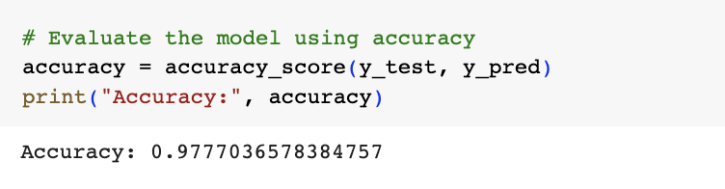
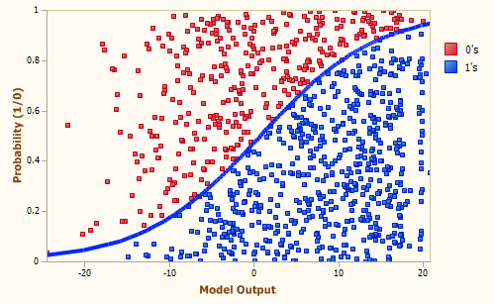
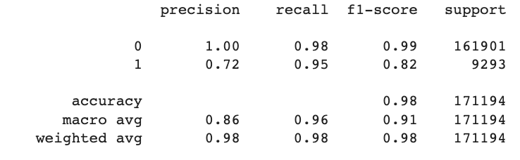
SKLearn ML
Model 5:
Logistical Regression
Log. Reg. is used to make a prediction about a categorical variable vs a continuous one (linear reg.)

Slide 30
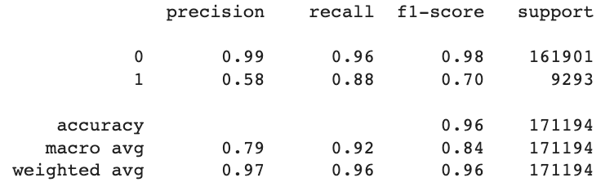
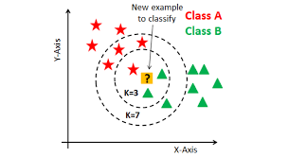
SKLearn ML
Model 6:
K-Nearest Neighbours
Assumes similar items are near each other
Sensitive to noise
Costly to calculate large, high-dimension data
Uses proximity, through Euclidean distance to make classifications by plurality voting.

Slide 31
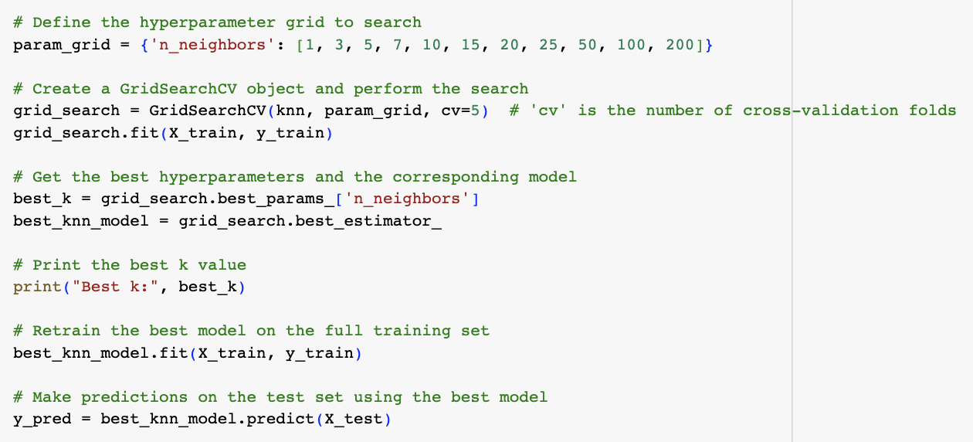
KNN: Grid Search for best value of K
Implementation code
First training results, where K = 5, led to a precision of 0.58/ recall of 0.88.
We perform grid search through brute force to run the same model through a range of values of K, to find the best performing model.
This approach is computationally expensive, but might lead to insights and better end performance of the model.

Slide 32
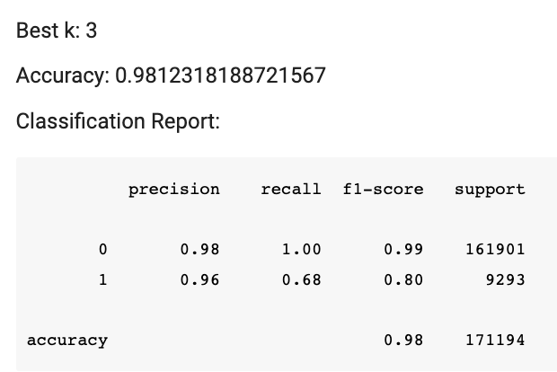
KNN: “Best value of K”
Implementation code
 | K = 5 | K = 3 | K = 50
Acc: | 0.96 | 0.98 | 0.93
Precision: | 0.58 | 0.96 | 0.42
Recall: | 0.88 | 0.68 | 0.94
f1-score: | 0.70 | 0.80 | 0.58

Slide 33
EVALUATE OUTCOMES

Slide 34
Evaluating Outcomes
All models chosen have displayed great accuracy of over 90% with little sign of overfitting. However, differences in machine learning models are still evident as presented in the following slides.

Slide 35
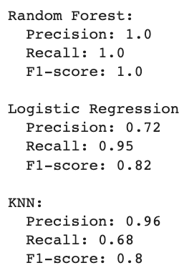
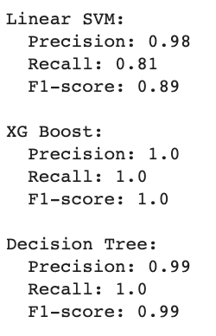
Side by side comparison of classification results
For default cases only:
default_ind = “1”

Slide 36
Models | XGBOOST | Linear Support Vector | Logistic Regression
Advantages | Excellent predictive performance. Efficient: scalable for large datasets. Regularization to prevent overfitting. | Effective for high-dimensional data. Regularization to prevent overfitting. | Simple and interpretable. Efficient: scalable for large datasets.
Disadvantages | Computational complex. Complexity: Extensive set of hyperparameters. | Computational complex. Less effective for non-linear data. | Limited expressiveness for complex relationship. Less effective for non-linear data.

Slide 37
Models | Decision Tree | Random Forest | KNN
Advantages | Simple and interpretable. No data normalization required: Decision Trees are not sensitive to data scaling. | High accuracy. Efficient: scalable for large datasets. Robust to outliers. | Simple to Understand and Implement. KNN can model complex non-linear relationships in the data, effective for datasets that do not follow linear patterns.
Disadvantages | Prone to Overfitting. Limited expressiveness for complex relationship. | May introduce bias in the presence of imbalanced datasets. | Computational complex. Curse of dimensionality.

Slide 38
CONCLUSION
Data exploration such as number of outliers can provide direction to data cleaning (scaling method that can be used)
Successful model training and evaluation is highly attributed to adequate cleaning & preprocessing of dataset.

